Slide 1
SPATIAL CLUSTERS AND CRASH FREQUENCY MODELING IN URBAN AREAS
MS in Infrastructure and Transportation Systems
Mario Alonso Peñaranda Márquez, C.E.
Department of Civil Engineering
Universidad Nacional de Colombia at Medellin

Slide 2
Data Set
The current research is been developed using a crash dataset given by the Department of Transportation (DOT) of Medellin, occurring during 2016 to 2019.
The database is composed of 178,320 records in the city of Medellin.
Variable | Description
ID | Unique crash record
Time-related | Date and hour
Accident type | Collision, conflagration, occupant fall, rollover, run over
Accident severity | Dead, injured, property damage
Vehicle type | Bus, automobile, bicycle, motorcycle, quadricycle, among others
Type of facility | Crosswalk, intersection, road segment, roundabout, among others
Driver-related | Gender and age
Localization | Crash address

Slide 3
Data Description

Slide 4
Data Description

Slide 5


Data Geocoding
Crash addresses were cleansed to standardize the string structure for geocoding. MapQuest API allows 15,000 free transactions per month and supported the geocoding of them in this project.
Using Python’s osmnx library, the bbox coordinates for Medellin were queried from Open Street Maps. Nearly 480 crash records fell outside the city, so a manual inspection was done to check the addresses spelling. After this procedure, 169 addresses were identified as possible errors, so were removed from the database.

Slide 6
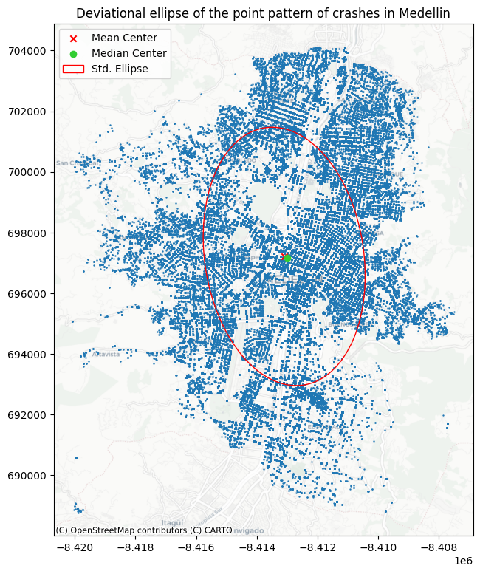
Point Pattern Analysis - Centrography
Variable | Value
Standard distance | 3,628 m
Major axis | 4,258 m
Minor axis | 2,622 m
Rotation | 0.149
Notes:
Standard distance: it is the average distance away from the center of the point cloud (center of mass). On average, crashes occurred around 3,628 m from the mean center.
Standard deviational ellipse: it reflects both its center and dispersion.

Slide 7
Important considerations
Maps considering Comunas and Neighborhoods. Land use maps were not useful in the specific problem.
There are island neighborhoods:
La Avanzada – Popular.
El Rincón – Belén.
Aures No. 2 – Robledo.
Major number of crashes by neighborhood:
La Candelaria, Perpetuo Socorro, Barrio Colón, San Benito (Candelaria).
Campo amor, Santa Fé (Guayabal).
Caribe, Castilla (Castilla).
Analysis by severity (Injured) was composed of 114,539.
Projected coordinate system EPSG 3857.
Geographic coordinate system EPSG 4326.
Notes:
Standard distance: it is the average distance away from the center of the point cloud (center of mass). On average, crashes occurred around 3,628 m from the mean center.
Standard deviational ellipse: it reflects both its center and dispersion.

Slide 8
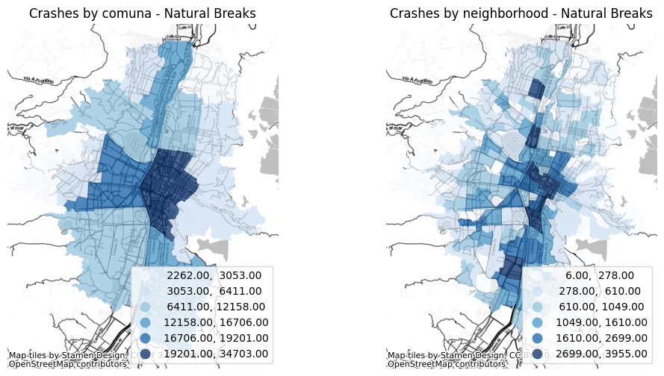
Point Pattern Analysis - Choropleths

Slide 9
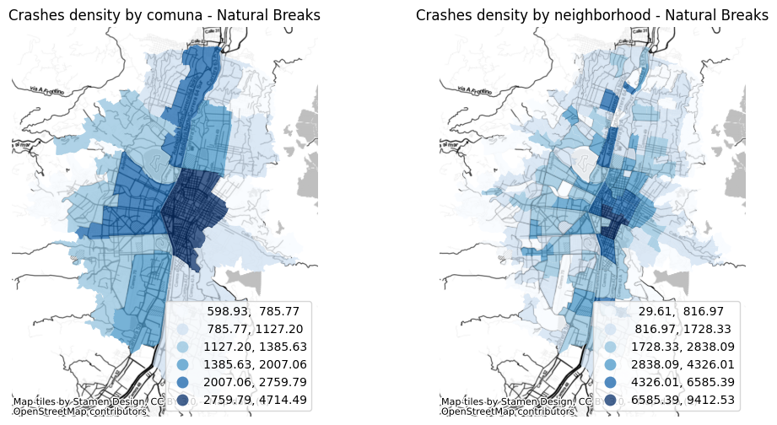
Point Pattern Analysis - Choropleths

Slide 10
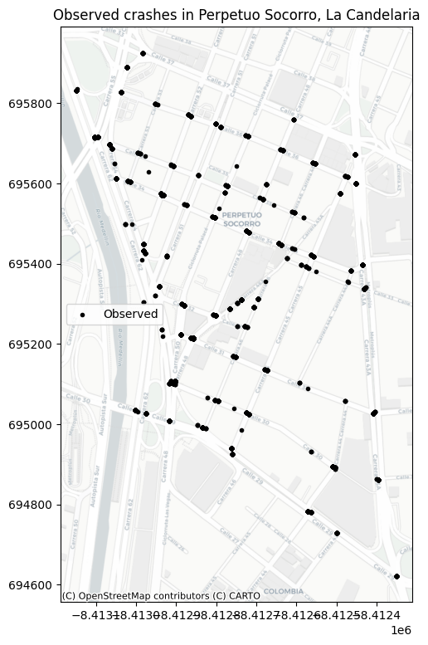
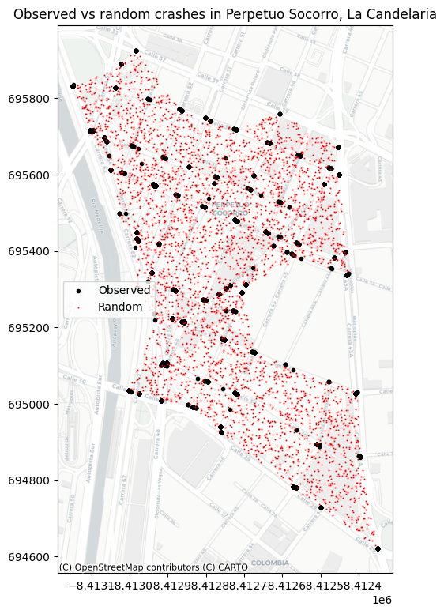
Point Pattern Analysis - Randomness

Slide 11
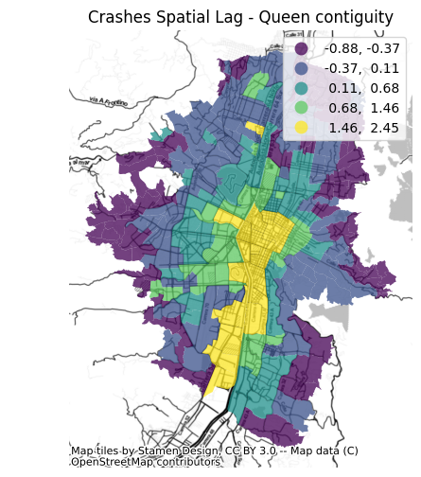
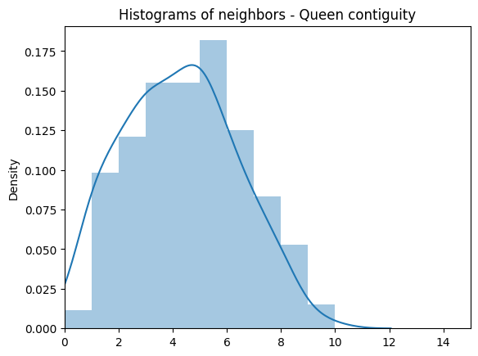
Global Spatial Autocorrelation
Queen contiguity
Statistic | Value
Moran’s I | 0.465
P-value | 0.001

Slide 12
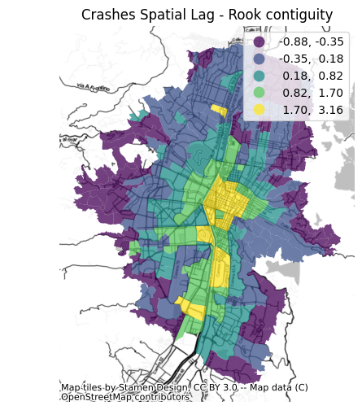
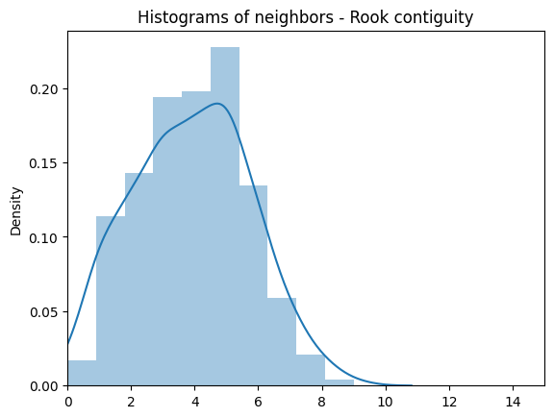
Global Spatial Autocorrelation
Rook contiguity
Statistic | Value
Moran’s I | 0.473
P-value | 0.001

Slide 13
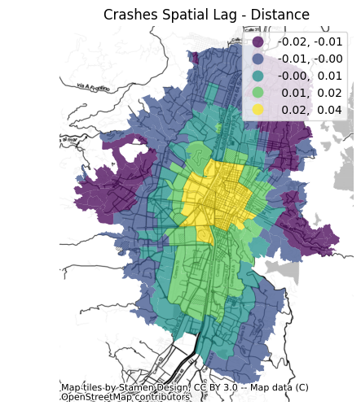
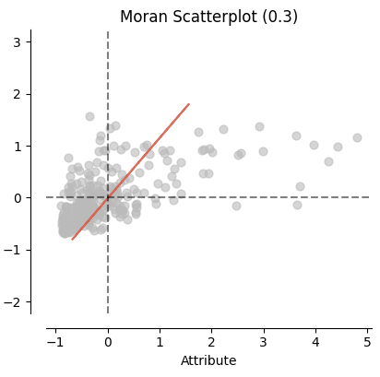
Global Spatial Autocorrelation
Distance
Statistic | Value
Moran’s I | 0.298
P-value | 0.001

Slide 14
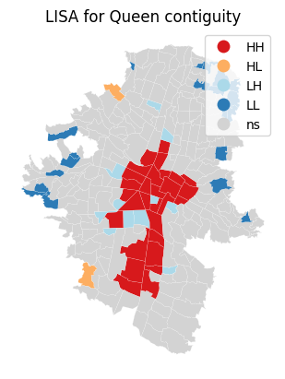
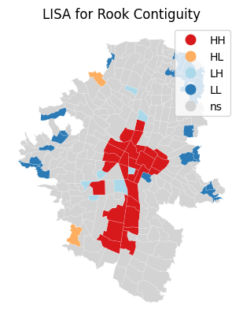
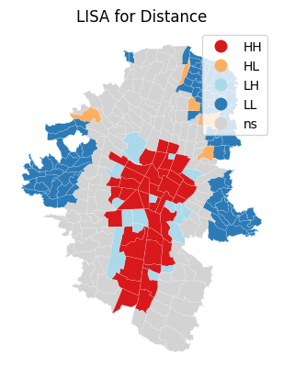
Local Spatial Autocorrelation

Slide 15
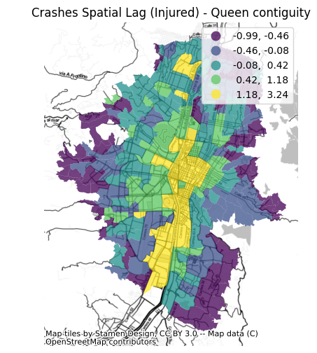
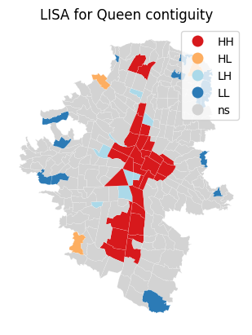
Spatial Autocorrelation by Injured Crashes
Statistic | Value
Moran’s I | 0.364
P-value | 0.001

Slide 16
Thanks!

